Slide 1

Bank Customer Churn Analysis
Apoorv Vats

Slide 2
Table of Contents
Project Overview
Problem Setting
Data Sources
Data Description
Data Exploration
Data Mining Tasks
Data Mining Models/Methods
Performance Evaluation
Project Results
Impact of the Project Outcomes
Future Scope

Slide 3
Project Overview
Bank churning is a practice where individuals regularly switch banks in order to take advantage of new account promotions and sign-up bonuses. The practice involves opening new accounts, meeting the required criteria to receive the bonus, and then closing the account before any fees are incurred.
It can be analyzed using data on account opening and closing dates, account balances, fees incurred, and bonus rewards earned. This data can be used to identify trends and patterns in churning behavior, as well as to evaluate the profitability of bank churning strategies.

Slide 4

Problem Setting
Knowing which clients are most likely to leave or stop using the bank service is known as customer churn prediction. This prognosis is significant for a lot of businesses. This is because it is frequently more expensive to acquire new clients than to keep old ones. When a customer is at risk of leaving, we need to know precisely what marketing efforts to make with them to increase the possibility that they will stay.

Slide 5

Data Sources
The data is taken from Kaggle.com. https://www.kaggle.com/datasets/gauravtopre/bank-customer-churn-dataset

Slide 6
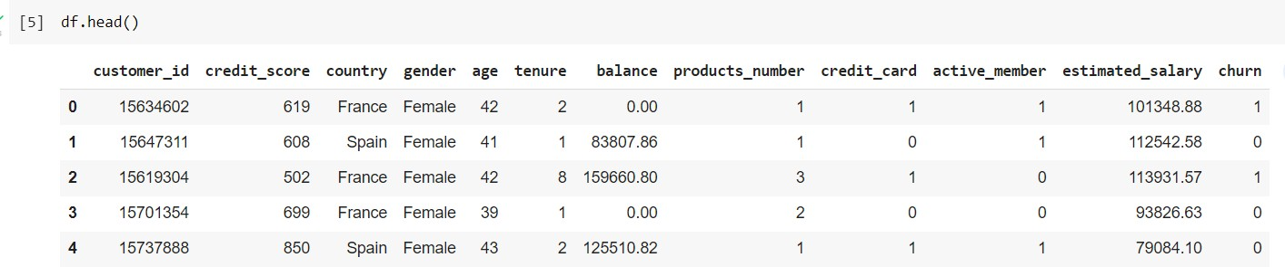
Data Description
Collect data on customer demographics, transaction history, and feedback. This dataset has 10,000 rows and 12 columns of data. It includes numerical predictors like credit score, age, tenure, balance, estimated salary, and categorical predictors like gender, country, age, active member, which will be used to predict the target variable churn (0 or 1)

Slide 7
Data Description
customer_id: A unique identifier for each customer (unused in this analysis)
credit_score: The customer's credit score, a numerical value used as an input in the analysis.
country: The country where the customer is located, a categorical variable used as an input in the analysis.
gender: The customer's gender, a categorical variable used as an input in the analysis.
age: The customer's age, a numerical variable used as an input in the analysis.
tenure: The number of years the customer has been with the bank, a numerical variable used as an input in the analysis.
balance: The customer's account balance, a numerical variable used as an input in the analysis.
products_number: The number of products the customer has with the bank, a numerical variable used as an input in the analysis.
credit_card: Whether or not the customer has a credit card with the bank, a binary variable used as an input in the analysis.
active_member: Whether or not the customer is an active member of the bank, a binary variable used as an input in the analysis.
estimated_salary: The customer's estimated salary, a numerical variable used as an input in the analysis.
churn: Whether or not the customer has churned (closed their account), the target variable for the analysis.

Slide 8
Data Exploration
There are numerical and categorical values in the dataset. Mean, median, and mode of the data are calculated for the numerical data. There are 10000 rows and 12 columns in the dataset.
The proportion of churned customers is inversely related to population of customers in a region, indicating a possible lack of customer service resources in those areas.
Proportion of female customers churning is higher than that of male customers.
Inactive members have a higher churn rate, and the overall proportion of inactive members is high, indicating a need for a program to turn them into active customers and reduce churn.

Slide 9
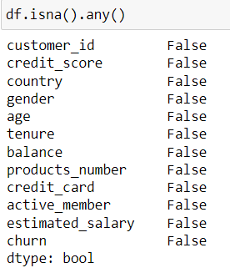
Data Exploration
There are no missing values in the dataset

Slide 10
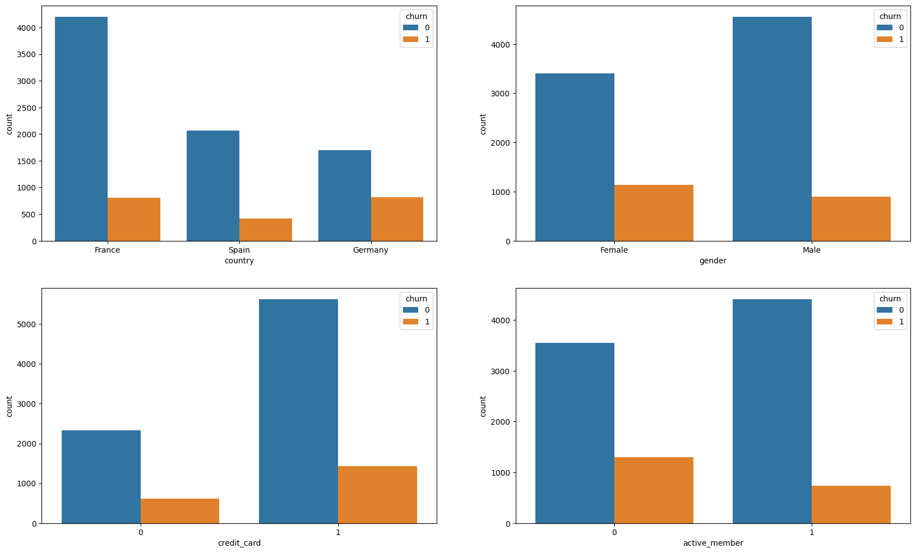
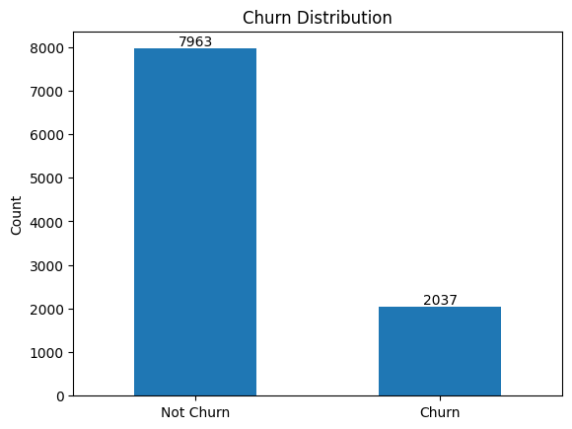
Data Exploration
Data Analysis on various columns
Checking if the data is balanced

Slide 11
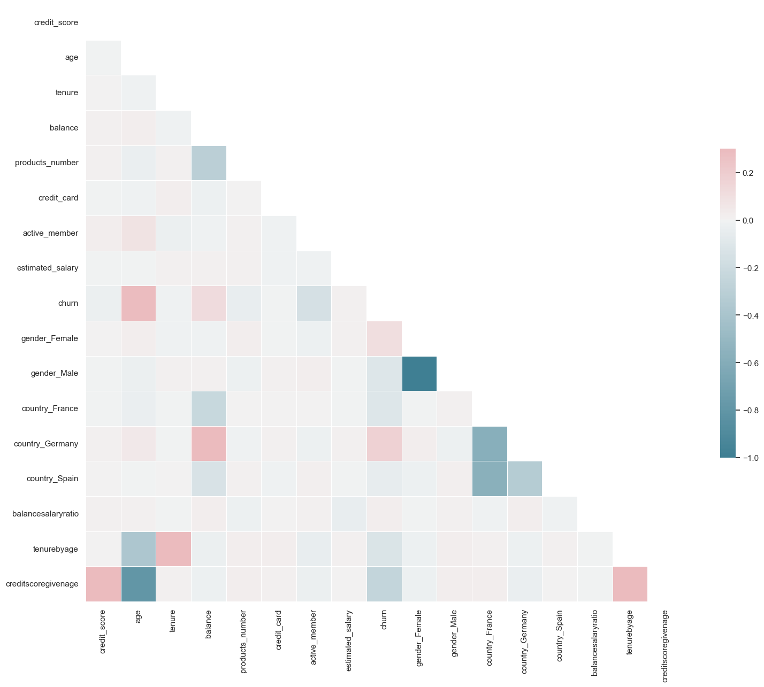
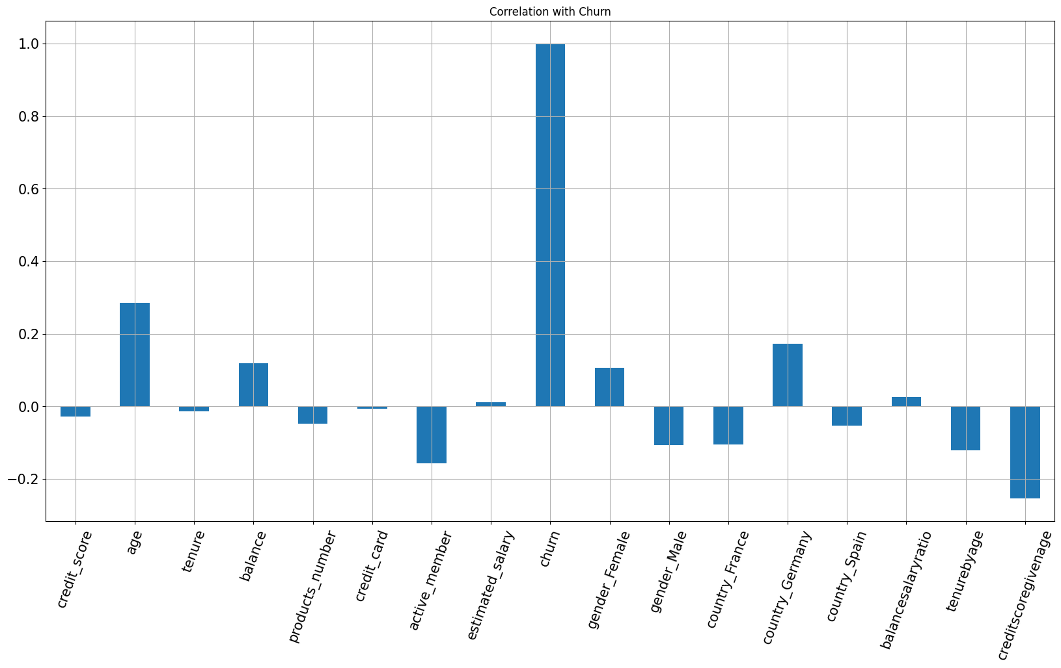
Data Exploration
Correlation Matrix
Correlation with response variable

Slide 12
Data Mining Tasks
Dimension Reduction and Variable Selection
Principal Component Analysis(PCA) was used to reduce the number of columns for prediction. We also used Pearson correlation for variable selection. Both these steps reduced the performance of the models, so they were removed.
Data Partition
Dataset is divided into training data(80%) which is used to train the model and test data (20%) that is used to evaluate performance of the model.
Fixing Data Imbalance
To fix this issue, we have performed Random Under Sampling.

Slide 13
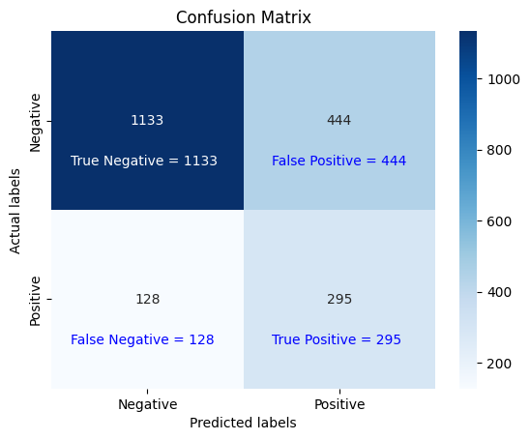
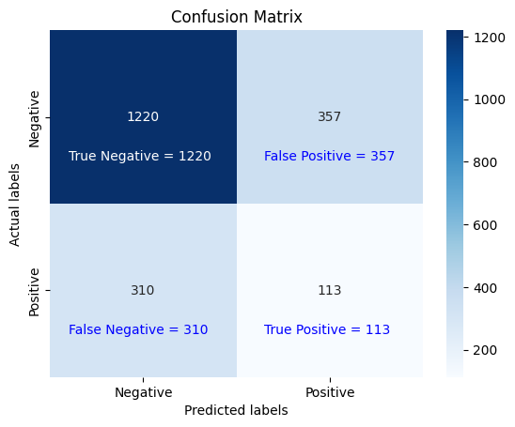
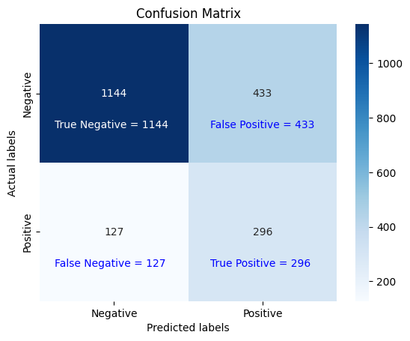



Logistic Regression
Data Mining Models
K-Nearest Neighbor
Support Vector Machine
Naive Bayes
Decision Tree
Random Forest

Slide 14
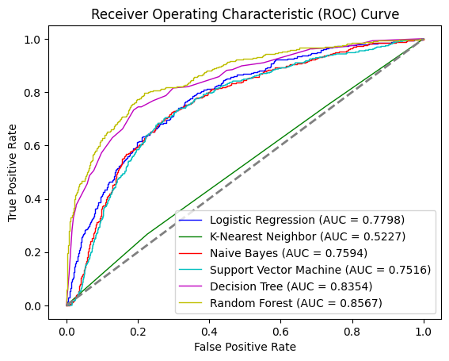
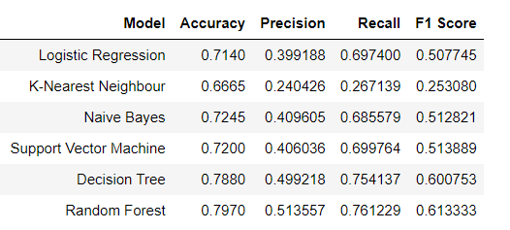
Performance Evaluation

Slide 15
Project Results
For our problem, Random Forest Classifier performs the best in all metrics.
It achieves an accuracy of 0.7970, precision 0.5135, recall 0.7612, f1-score 0.6133, and AUC of 0.8567.

Slide 16
Impact of the Project Outcomes
Improved customer retention: By identifying customers who are at risk of leaving, banks can take proactive steps to retain them, such as offering incentives or personalized services.
Cost savings: Banks can identify customers who are likely to churn the company can focus their marketing efforts on them instead of all customers.
Enhanced profitability: By reducing churn rates, banks can improve their profitability over the long term by retaining more customers.

Slide 17
Future Scope
Enhancing the predictive accuracy: The accuracy of the churn prediction model can be improved by incorporating more features and data sources, such as transactional data, social media, and feedback data.
Incorporating real-time data: Banks can integrate real-time data sources, such as social media and customer support chats, into their churn prediction models to identify customers who are at risk of churn in real-time. This would enable banks to take immediate action to retain these customers.

Slide 18
Thank You

